Slide 1
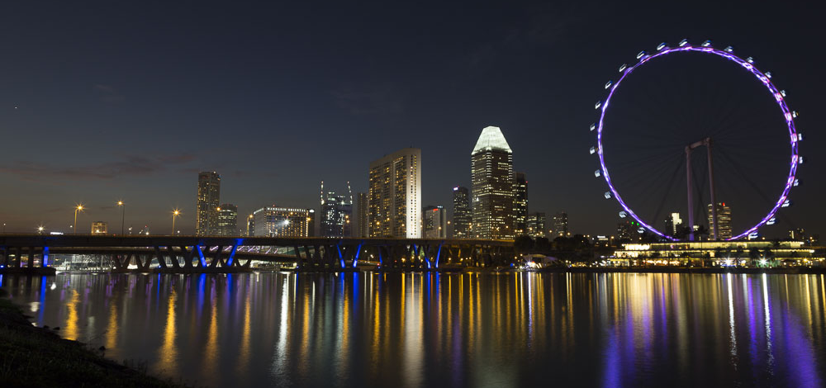





PowerShell Conference Asia

Slide 2

Knock, knock
Linux at your door
PowerShell Conference
Singapore 2017

Slide 3
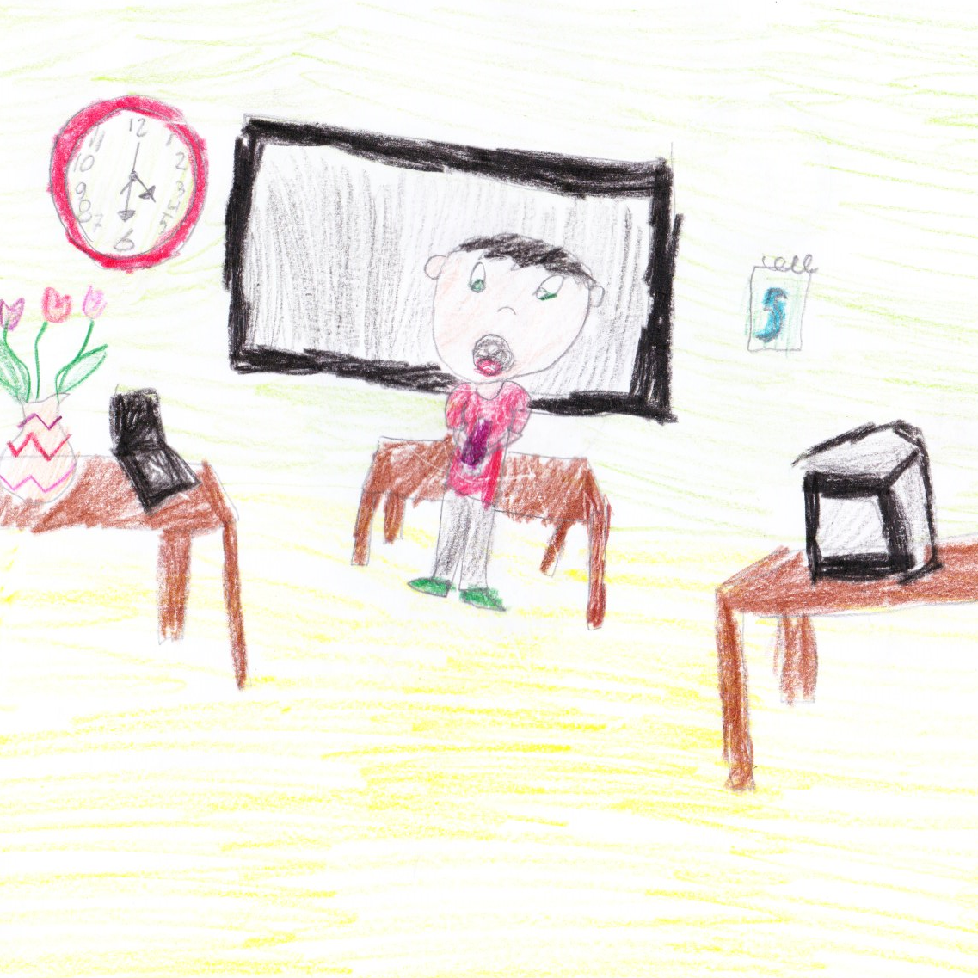
About me
Microsoft MVP: PowerShell CDM
Windows Engineer: Optiver (NL)
“PowerShell 5.0 Biblia” (PL)
PowerShellPL.NET
becomeLOTR.wordpress.com
@bielawb
PowerShell Conference
Singapore 2017

Slide 4

The Plan
Why?
PyWinRM explained
Ansible via CLI
AWX
Q&A

Slide 5

Q & A

Slide 6
Don’t Forget!
Fill in your survey in Mobile app – it’s how we do better!
Don’t lose you badge! You need it for the Social Events
Grab the Speakers for a chat – they all have time for you!
Let everyone know what they are missing on Social Media
#PowerShell
#PSConfAsia
Photos of Marina Bay Credit: Sebastian Szumigalski
PowerShell Conference
Singapore 2017

